Slide 1
MULTIPLE MEANING WORDS HOMEWORK CHALLENGE
*IF YOU ARE HAVING TROUBLE CLICKING THE LINKS, MAKE SURE YOU ARE LOOKING AT IT IN PLAY MODE!
THINK OF A MULTIPLE MEANING WORD THAT YOU FEEL IS VALUABLE OR MEANINGFUL TO YOU. MAYBE IT DEFINES YOU IN SEVERAL WAYS, LIKE IN THE EXAMPLES I WILL SHOW YOU NEXT. YOUR WORD MUST HAVE A VARIETY OF MEANINGS, NOT JUST ONE. I WOULD LIKE YOU TO CONSIDER A WORD THAT HAS A BOTH A LITERAL AND FIGUREATIVE MEANING IF YOU COULD ALSO. YOUR HOMEWORK WILL BE TO WRITE A PARAGRAPH WHICH REFLECTS ON THE WORD.
YOU MAY WANT TO LOOK ONLINE (AKA GOOGLE) TO FIND DIFFERENT MULTIPLE MEANING WORDS THAT YOU CAN CHOOSE FROM. (SEE LAST SLIDE FOR IDEAS)
YOUR WORD SHOULD BE THE TITLE OF YOUR PAGE. IT SHOULD BE WRITTEN IN THE CENTER OF THE FIRST LINE, NEATLY.
WRITE THE DEFINITIONS OF THE WORD YOU SELECTED UNDERNEATH YOUR WORD.
THEN WRITE A REFLECTION PARAGRAPH THAT EXPLAINS HOW THIS WORD IS USED IN A VARIETY OF WAYS, ALL OF WHICH DEFINE YOU IN A WAY OR MEAN SOMETHING TO YOU. (THINK OF IT LIKE WRITING DOWN WHAT YOU WOULD SAY IF YOU WERE THIS ARTIST AND THIS WAS THE WORD YOU WERE HIGHTLIGHTING FROM YOUR NEW ALBUM LIKE IN THESE NEXT VIDEOS.)
GOOD LUCK! I CAN’T WAIT TO READ THEM!
DUE ON FRIDAY!

Slide 2
HOMEWORK EXAMPLES
EXAMPLE ONE
EXAMPLE TWO
^ CLICK ^

Slide 3
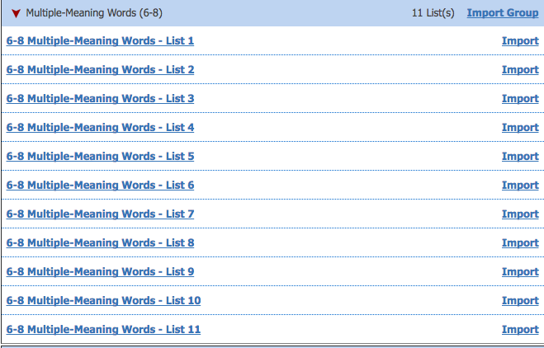
MULTIPLE MEANING WORDS – FINDING THE RIGHT WORD FOR YOU – HELP FROM THE TEACHER!
LIST OF MULTIPLE MEANING WORDS: CLICK HERE FOR LINK TO WEBPAGE
LIST BY GRADE: CLICK HERE FOR LINK TO WEBPAGE
DOWNLOADABLE LIST: CLICK HERE FOR LINK
DOWNLOADABLE LIST: CLICK HERE FOR LINK
ON THIS LINK YOU CAN CLICK THE DROP DOWN AS SEEN IN THE PHOTO BELOW AND FIND ELEVEN DIFFERENT LISTS TO HELP YOU FIND AN IDEA:

Slide 4
What the IRWN page should look like:
BUT WITH YOUR ANSWERS WRITTEN
…USING COMPLETE SENTENCES, PROPER GRAMMAR, AND CORRECT PUNCTUATION.

